Slide 1

Design Assignment-2
EC22B1011 - SONU
Ec22b1014 – ADVIK
EC22B1021 – NIKITA N A
EC22B1063 – P SAMARESH

Slide 2
EXERCISE 1 . 1: EARLY-STAGE STARTUP GUIDING PRINCIPLES
Customer-Centric Innovation:
Focus on identifying and solving a specific customer pain point, such as creating a seamless checkout experience with the Smart Cart.
- Regularly gather user feedback to iterate and refine the product.
2. Agility and Speed:
- Prioritize speed in decision-making and product iteration. Rapid prototyping and A/B testing help in refining features based on real-world feedback.
- Operate in a lean, adaptable manner, ready to pivot based on new information or market demand.
3. Resource Efficiency:
- Optimize resources by minimizing overhead, leveraging shared services, and maintaining a small, multi-functional team.
- Use open-source software and cloud services to reduce costs and focus investment on critical differentiating technology.
4. Scalability Focus:
Design the technology and infrastructure with scalability in mind
Plan for how the service can expand to new markets or demographics as the startup grows.

Slide 3
5. Culture of Experimentation and Learning:
- Encourage a test-and-learn approach. Failures are considered learning opportunities that inform better decisions in the future.
- Embrace a data-driven culture where key metrics guide decisions.
6. Building Strong Partnerships:
Develop relationships with strategic partners early, such as retailers, technology vendors, or payment processors, to enhance capabilities and credibility.
- Consider co-development or pilot programs with key customers to validate the solution.
LARGE COMPANY GUIDING PRINCIPLES
Customer Trust and Reliability:
- Prioritize reliability and consistency, especially if customers are accustomed to a trusted service experience.
- Maintain strict data privacy and security measures to protect customer information.
2. Operational Excellence and Efficiency:
- Emphasize process optimization and efficiency to scale operations seamlessly across multiple locations or regions.
- Standardize practices across teams and locations for consistent service delivery and cost management.

Slide 4
3. Brand Integrity and Corporate Responsibility:
Ensure all business activities align with the company’s brand values and contribute to a positive public perception.
Invest in sustainable practices and social responsibility initiatives, such as environmentally friendly Smart Cart hardware or ethical sourcing.
4. Innovation with Strategic Focus:
While innovation remains important, it’s typically more structured, with a focus on incremental improvements or diversification in line with the company’s strategic direction.
Large companies might fund internal R&D or collaborate with startups to explore cutting-edge technologies while mitigating risk.
5. Data-Driven Insights and Optimization:
Use sophisticated analytics to understand customer behaviour , optimize in-store experiences, and drive new product features.
Data also informs supply chain management and predictive maintenance for hardware (e.g., ensuring Smart Carts remain operational).
6. Risk Management and Compliance:
- A large company must ensure compliance with industry regulations, data protection laws, and safety standards.
- Strong risk management frameworks are essential to mitigate any financial, operational, or reputational risks.

Slide 5
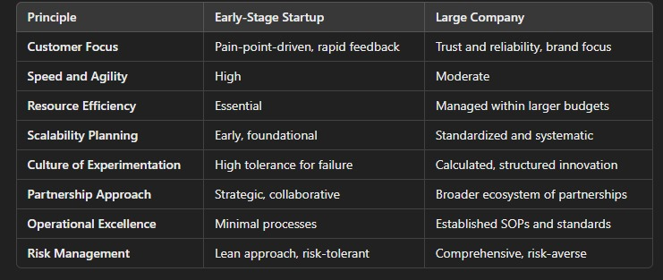
SUMMARIZING POINTS:

Slide 6
EXERCISE 1 . 2: BUSINESS STRATEGY:
Business Objective:
Reduce checkout times and enhance customer shopping experiences in grocery stores. Increase sales and customer satisfaction through technology-driven solutions.
Product Overview:
A smart grocery cart equipped with scanning technology that allows customers to scan items as they shop, keeping a running total of their purchases. Features like real-time inventory management, user-friendly interface, and integration with loyalty programs.
Technology Integration:
Utilize RFID and barcode scanning technology for seamless item recognition.
Implement IoT connectivity to sync with store inventory systems, ensuring accurate product availability. Develop a mobile app for customers to track their purchases, access promotions, and receive personalized recommendations.
Scientific Foundation:
Leverage data analytics to understand customer shopping patterns and preferences, improving inventory management and marketing strategies. Apply machine learning algorithms to enhance the cart’s functionality, such as suggesting items based on previous purchases or optimizing shopping routes in-store.

Slide 7
Creative Connection:
Foster partnerships with grocery chains to pilot the smart carts, collecting feedback for continuous improvement. Explore eco-friendly materials and energy-efficient designs to appeal to environmentally conscious consumers. Integrate augmented reality features for in-cart navigation and promotional displays, creating an engaging shopping experience.
Market Positioning:
Position the smart grocery cart as an innovative solution for tech-savvy consumers looking for convenience. Highlight benefits such as reduced waiting times and enhanced shopping experiences in marketing campaigns.
Growth Strategy:
Expand the technology to include features like automatic checkout and payment processing.
Explore international markets and adapt the product to local shopping habits and preferences.
By strategically aligning business objectives, product features, technology capabilities, and scientific insights, the smart grocery cart can significantly enhance the grocery shopping experience, leading to increased customer loyalty and market share.

Slide 8
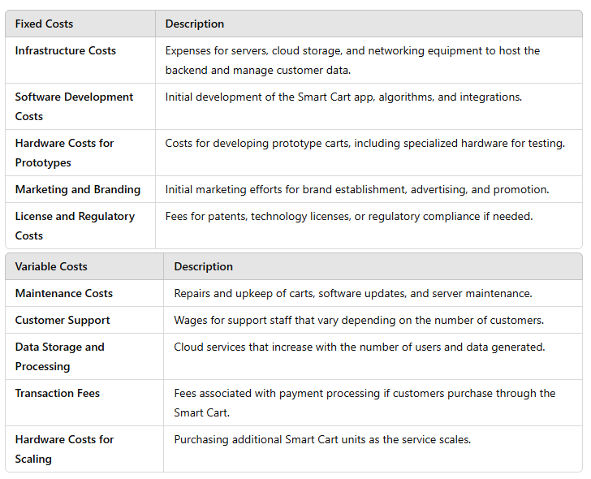
EXERCISE : 2 . 1
A. FIXED VS. VARIABLE COSTS:
Fixed Costs:
Costs that do not vary with the number of units produced or service delivered
Variable Costs:
Costs that change with the level of production or service provided):

Slide 9
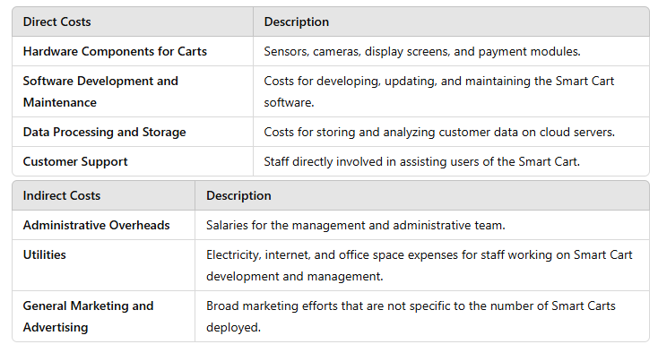
EXERCISE : 2 . 1
B . DIRECT VS. INDIRECT COSTS
Direct Costs:
Directly associated with delivering the Smart Cart service.
Indirect Costs:
Not directly tied to a specific unit of service.

Slide 10
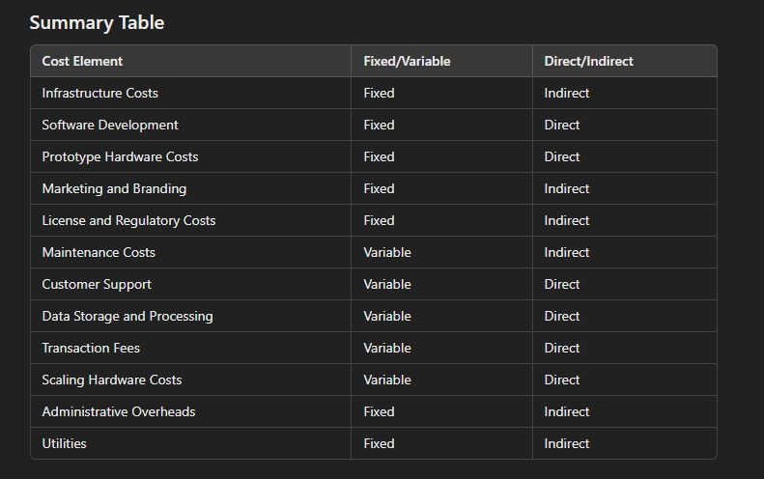
SUMMARIZED TABLE:

Slide 11
EXERCISE: 2 . 2
Fixed vs Variable cost for software product usage
As a fixed cost:
If the software is purchased outright, the cost can be amortized over the lifetime of the product. This means that the cost is spread out evenly over the years, rather than being incurred all at once.
As a variable cost:
If the software is leased or subscription-based, the cost can be directly attributed to the number of units produced. This means that the cost will increase as more units are produced.
As a semi-variable cost:
If the software is used for both development and production, the cost can be allocated to each based on a predetermined formula. For example, the cost of the software could be allocated 50% to development and 50% to production.

Slide 12
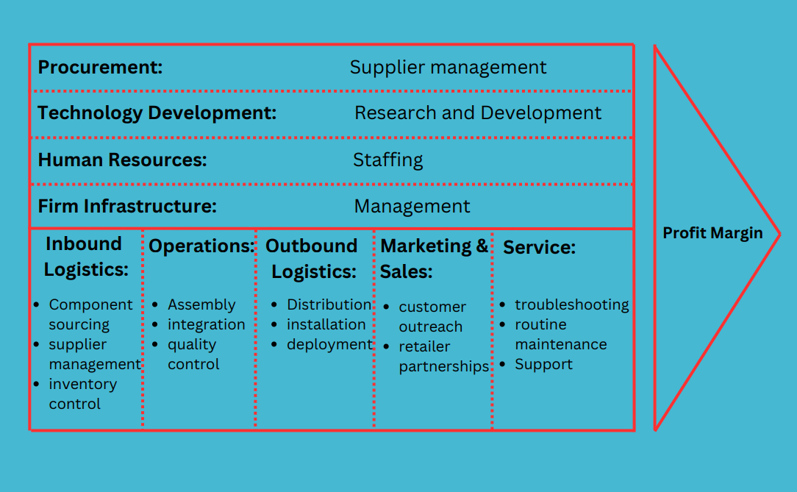
EXERCISE: 3 . 1:

Slide 13
The image shows a Value Chain model, which outlines a company's primary and support activities that add value and increase profit margins.
In retail technology, like Walmart's smart shopping cart initiative, each element supports seamless product creation and customer satisfaction.
Primary activities include sourcing components, assembling, distributing, marketing, and providing service for the carts.
Support activities, such as supplier management, R&D, staffing, and infrastructure, enhance these operations, giving Walmart a competitive edge and maximizing value across its chain.

Slide 14
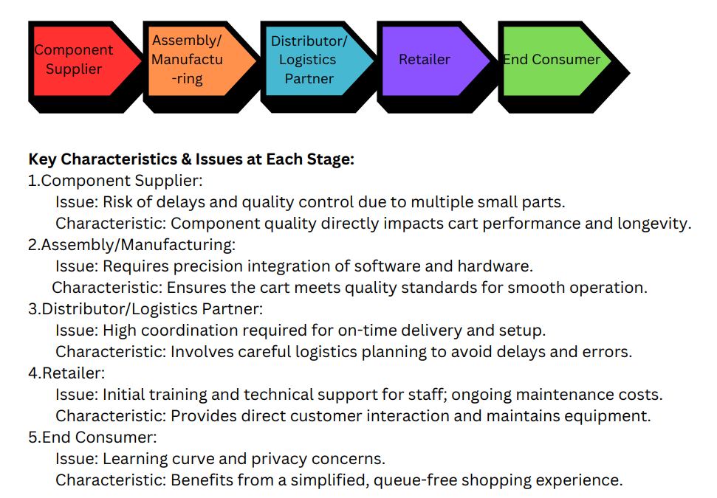
EXERCISE: 3 . 2:

Slide 15
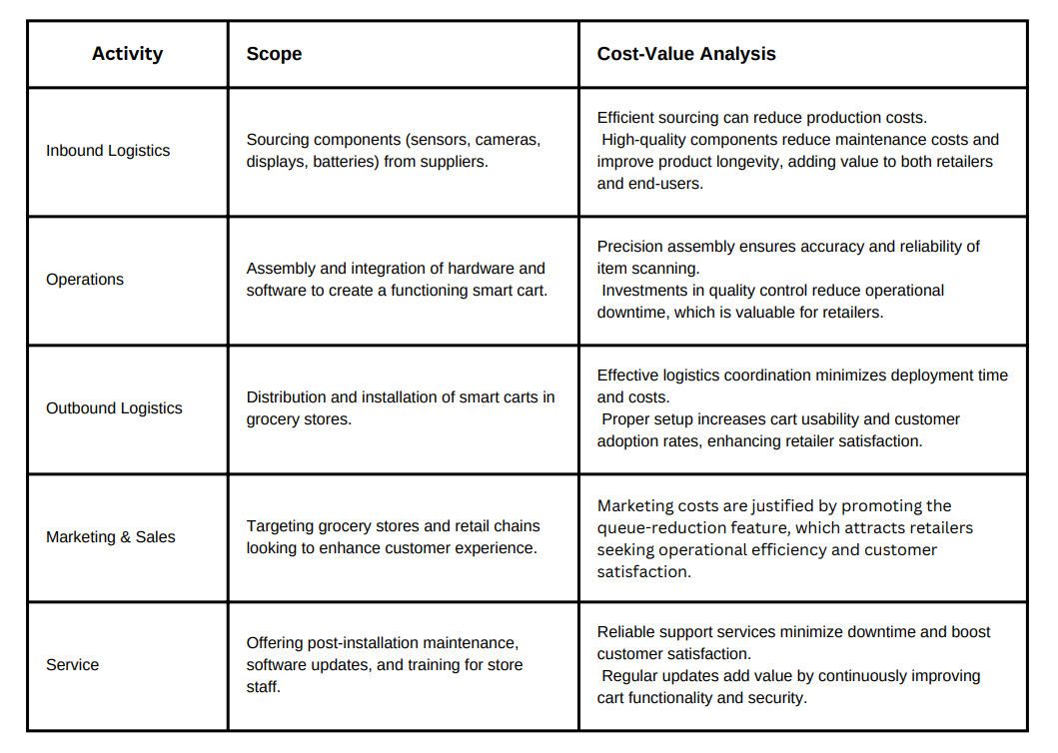
EXERCISE: 3 . 2:

Slide 16
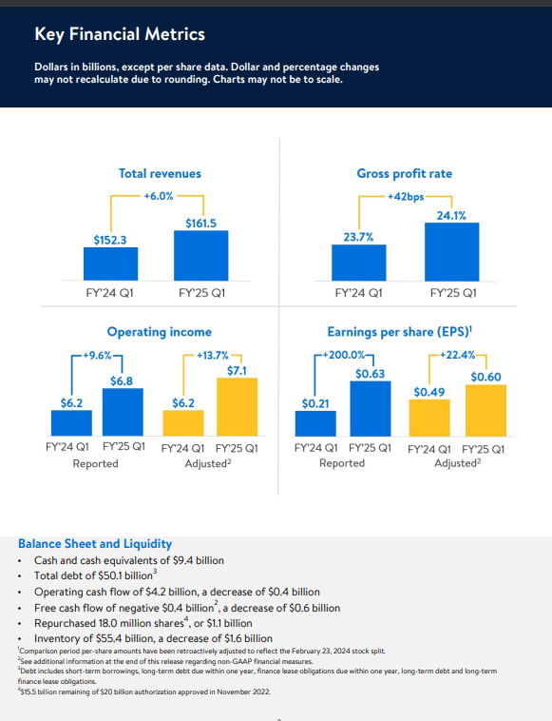
EXERCISE 4: (Financial Management) Both 4a and 4b combined Comparing the income statements and Balance sheets for the past two quarters of the current financial year and with previous year :
1. WALMART:
QUARTER 1:

Slide 17
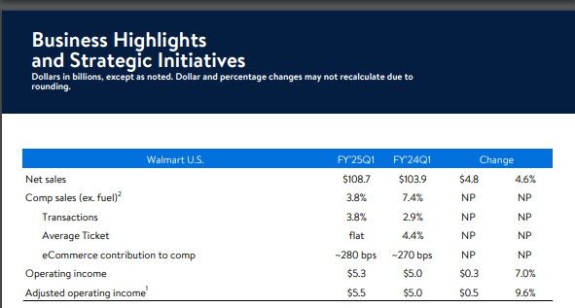
Balance Sheet and Liquidity :
• Cash and cash equivalents of $9.4 billion
• Total debt of $50.1 billion
• Operating cash flow of $4.2 billion, a decrease of $0.4 billion
• Free cash flow of negative $0.4 billion, a decrease of $0.6 billion
• Repurchased 18.0 million shares, or $1.1 billion
• Inventory of $55.4 billion, a decrease of $1.6 billion.

Slide 18
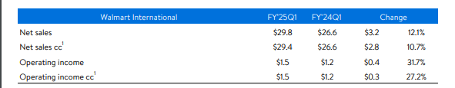
Walmart U.S:
• Sales reflected strength in transaction counts and unit volumes; like-for-like inflation slightly positive
• Value-convenience proposition is resonating; share gains primarily driven by upper-income households
• Growth in eCommerce of 22%, led by store-fulfilled pickup & delivery and marketplace
• Walmart Connect advertising sales grew 26%; strong growth in advertiser counts, including marketplace sellers
• Gross profit rate increased 46 bps; membership income increased; operating expense deleveraged 48 bps
• Inventory declined 4.2% with sustained strong sales and higher in-stock levels

Slide 19
Walmart International :
• Growth in net sales cc of 10.7% led by Walmex, China and Flipkart
• eCommerce sales up 19%, led by store fulfilled pickup & delivery and marketplace. Penetration up across markets
• Advertising business grew 27%, led by Flipkart and Walmex
• Strength in food and consumables as well as improved growth in general merchandise
• Gross profit rate increased 32bps due to improved eCommerce margins and growth in higher-margin services
• Operating income cc up 27.2% with strength across markets and benefiting from lower losses in eCommerce

Slide 20
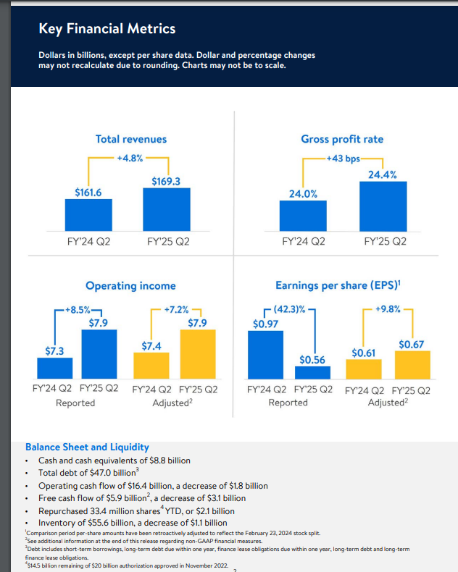
QUARTER 2 :
Balance Sheet and Liquidity :
• Cash and cash equivalents of $8.8 billion
• Total debt of $47.0 billion
• Operating cash flow of $16.4 billion, a decrease of $1.8 billion
• Free cash flow of $5.9 billion, a decrease of $3.1 billion
• Repurchased 33.4 million shares YTD, or $2.1 billion
• Inventory of $55.6 billion, a decrease of $1.1 billion

Slide 21
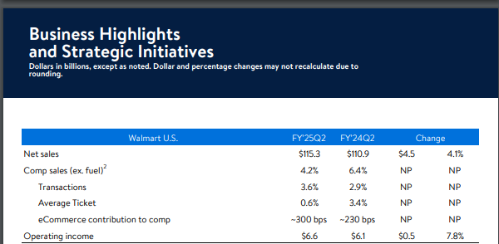
Walmart’s financials show $8.8 billion in cash for solid liquidity, but with $47.0 billion in debt, higher interest expenses could pressure net income. Operating cash flow decreased by $1.8 billion, and free cash flow by $3.1 billion, indicating possible rises in operating costs and capital investments. The $2.1 billion share buyback boosts shareholder value yet limits cash for growth. Inventory decreased by $1.1 billion, which could reflect efficiency gains but may impact revenue if demand slows. Overall, net income growth appears challenged by increased costs, debt servicing, and reinvestment—insights best verified in Walmart’s full annual report.

Slide 22
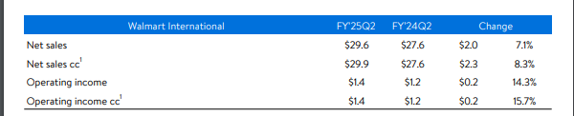
Walmart U.S :
• Sales reflected strength in transaction counts and unit volumes; like-for-like inflation slightly positive
• Value-convenience proposition is resonating; share gains primarily driven by upper-income households
• Growth in eCommerce of 22%, led by store-fulfilled pickup & delivery and marketplace
• Walmart Connect advertising sales grew 26%; strong growth in advertiser counts, including marketplace sellers
• Gross profit rate increased 46 bps; membership income increased; operating expense deleveraged 48 bps
• Inventory declined 4.2% with sustained strong sales and higher in-stock levels

Slide 23
Walmart International :
• Growth in net sales cc1 of 10.7% led by Walmex, China and Flipkart
• eCommerce sales up 19%, led by store fulfilled pickup & delivery and marketplace. Penetration up across markets
• Advertising business3 grew 27%, led by Flipkart and Walmex
• Strength in food and consumables as well as improved growth in general merchandise
• Gross profit rate increased 32bps due to improved eCommerce margins and growth in higher-margin services• Operating income cc1 up 27.2% with strength across markets and benefiting from lower losses in eCommerce

Slide 24
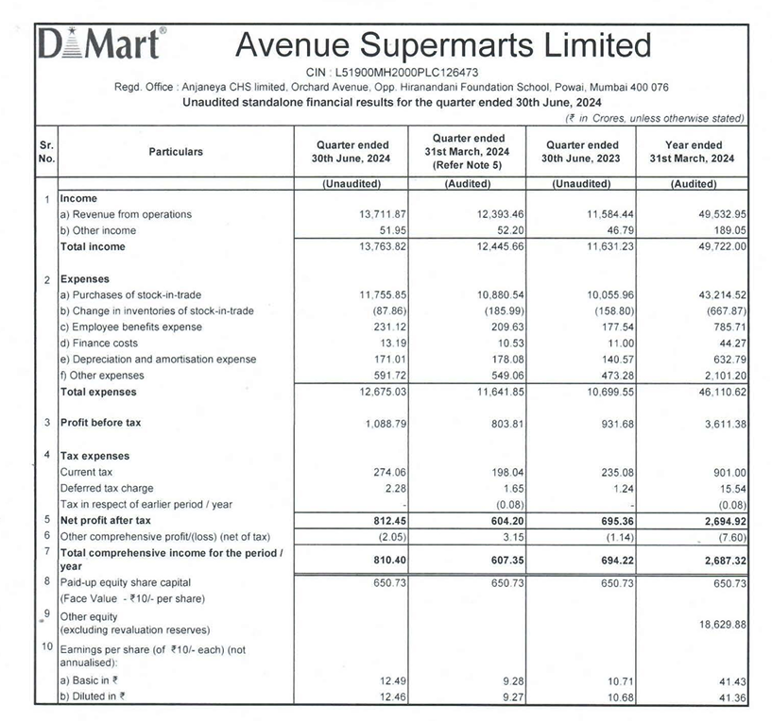
1. D-MART:
QUARTER 1:

Slide 25
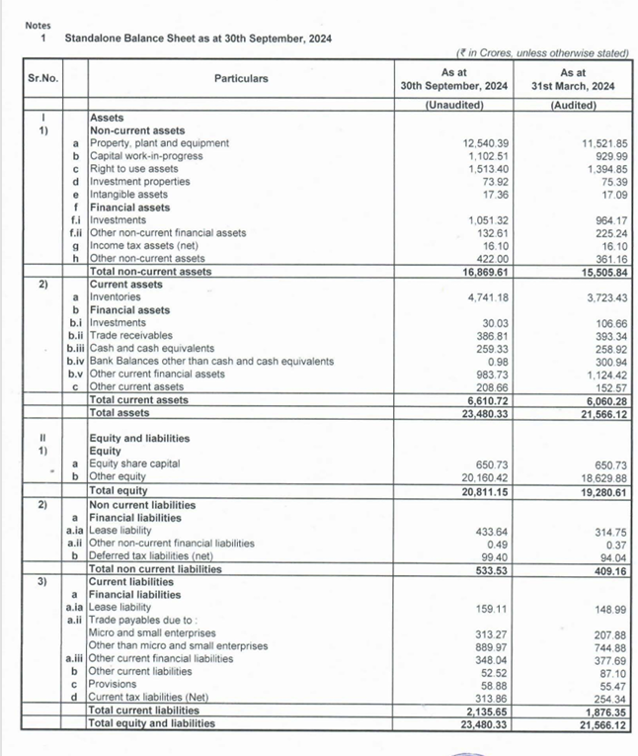
QUARTER 2:

Slide 26
Revenue Growth: Revenue from operations grew by 18.4% year-over-year from ₹11,584.44 crore in Q1 2023 to ₹13,711.87 crore in Q1 2024. This indicates strong operational performance and potentially higher sales volumes or increased store count.
Cost Management: Total expenses also rose, but at a lower rate than revenue. The increase in expenses (from ₹10,699.55 crore in Q1 2023 to ₹12,675.03 crore in Q1 2024) suggests DMart is managing costs effectively despite inflationary pressures.
Other Expenses: The increase in employee benefits expense and other operational costs (like depreciation) may also indicate higher staffing and infrastructure investments to support store expansion
The operating margin remained relatively stable, indicating DMart’s efficiency in managing its operational costs. A consistent margin shows DMart’s ability to keep costs in check relative to revenue.
slight decrease in net profit margin may result from increased expenses in areas such as employee benefits, finance costs, and depreciation, as DMart invests in expanding its infrastructure.
ROE(return on equity) is a crucial metric to gauge the company’s profitability relative to its equity. A strong ROE aligns with DMart’s goal to generate returns for shareholders while maintaining financial stability.
DMart’s key financial metrics provide insights into its ability to maintain profitability while expanding. The stable operating margin and controlled expenses indicate efficient cost management, which supports growth and expansion goals. DMart’s consistent ROE and operating margins reflect its ability to finance growth through internal funds, which could allow it to expand without relying heavily on external debt.

Slide 27
Exercise 5.1: HR Plan for Smart Shopping Cart Firm
A. Role: Product Manager – Smart Shopping Cart
Lead product development and launch of smart shopping cart.
Coordinate with engineering, design, and marketing teams.
Conduct market research to improve features and gather user feedback.
Manage project timelines, budgets, and resources.
GOALS:
Launch the smart shopping cart within 12 months.
Reduce checkout time by 25% within six months of launch.
Increase customer satisfaction by 30% within a year.
RESPONSIBILITIES:

Slide 28
B. Critical Competencies:
Knowledge of IoT and retail technology (e.g., RFID, barcode scanning).
Strong project management skills for coordinating cross-functional teams.
Customer-centric mindset to prioritize features based on user needs.
Effective communication for collaborating with technical and non-technical teams.
Problem-solving skills to adapt based on testing and feedback.
C . Job Profile/Description:
Title: Product Manager – Smart Shopping Cart
Description: Lead development of a smart shopping cart to streamline the checkout process, enhancing customer experience by reducing queues.
Responsibilities: Oversee product lifecycle, gather customer feedback, manage timelines/budgets, and track post-launch metrics.
Qualifications: Bachelor’s in Product Management or related field; 5+ years in product management; experience with IoT or retail solutions.
Benefits: Competitive salary, growth opportunities, and a collaborative environment.

Slide 29
Exercise 5.2: Mock Interview Setup
INTERVIEW SETUP:
Panel: Head of Engineering (technical questions) and Head of Marketing (customer-centric questions).
Candidates: Two candidates, one with IoT background (Candidate 1) and one with strong customer focus (Candidate 2).
INTERVIEW QUESTIONS:
Technical: Experience with IoT, integrating barcode/RFID, and ensuring scalability.
Customer-Centric: Strategies for gathering customer feedback, prioritizing features, and refining products based on market needs.
Project Management: Managing cross-functional teams, communicating delays, and tracking product success metrics.

Slide 30
Criteria | Candidate 1 Score (out of 5) | Candidate 2 Score (out of 5) | Comments
Technical Knowledge | 4 | 3 | Candidate 1 has strong experience with IoT and retail tech, while Candidate 2 has general tech knowledge.
Customer-Centric Approach | 3 | 5 | Candidate 2 demonstrated a deep understanding of customer needs and prioritizing features accordingly.
Project Management Skills | 4 | 4 | Both candidates have solid project management skills, with a structured approach to timelines and team handling.
Problem-Solving Ability | 4 | 3 | Candidate 1 provided creative solutions for product scalability, while Candidate 2 was less specific.
Overall Communication Skills | 3 | 4 | Candidate 2 communicated ideas clearly and effectively, making them easier to understand for non-technical team members.

Slide 31
Feedback:
Overall Recommendation:
Candidate 1 may be preferable if technical implementation and integration are the main priorities.
Candidate 1: Strong technical background makes them well-suited for managing the technical aspects of the smart shopping cart. However, they could improve in understanding and prioritizing customer needs.
Candidate 2: Excellent understanding of customer needs and communication skills make them a good fit for balancing technical development with customer satisfaction. However, they could benefit from further technical knowledge related to IoT.
Candidate 2 is recommended if the focus is on a customer-centric approach and communication with diverse teams.

